Slide 1
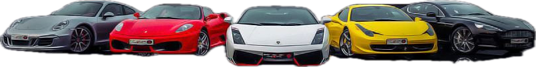
Project: Analysing the Impact of Car Features on Price and Profitability

Slide 2
Content
1
2
3
4
Insight
5
Result
Project Description
Approach
Tech – Stack Used

Slide 3
Project Description
The primary goal of this project is to assist a car manufacturer in optimizing pricing strategies and product development decisions to maximize profitability while meeting consumer demand.
This involves analysing a comprehensive dataset encompassing various car attributes, market segments, and pricing information.
About Dataset:
The dataset "Car Features and MSRP" provides details about different car models, their specifications, and the Manufacturer's Suggested Retail Price (MSRP) collected by Cooper Union, a New York City-based private college.
The dataset offers information on:
Observations: There are 11,159 entries (rows) in the dataset.
Variables: It includes 16 different attributes (columns) describing various features of the cars, such as engine type, fuel efficiency, horsepower, transmission, fuel type, market category, and more.

Slide 4
Approach
Data Preparation:
Data Cleaning: Removal or imputation of null values, elimination of duplicates, handling outliers, and removal of irrelevant columns to ensure data quality.
Exploratory Data Analysis (EDA):
Descriptive Statistics: Calculating summary statistics like mean, median, standard deviation, etc., to understand the central tendency and variability in the data.
Pivot Tables and Functions: Using pivot tables and functions to aggregate and summarize data across different dimensions and variables.
Graphs/Charts: Visual representation of data using graphs and charts to identify patterns, trends, and relationships within the dataset.
Statistical Analysis:
Regression Analysis: Employing regression techniques to model relationships between variables, understanding how certain factors impact others, and predicting outcomes.
Correlation Analysis: Determining the strength and direction of relationships between variables using correlation coefficients.
Dashboard Creation:
Utilizing Tableau or similar tools to create interactive dashboards summarizing key findings and insights derived from the analysis.

Slide 5
Tech- Stack Used
The analysis for this project has been performed using Microsoft Excel as it offers a user-friendly interface that allows users to work with data, perform calculations, and create visual representations without extensive programming knowledge.

Slide 6
Descriptive Statistics
Categorical Attributes
Column_name | Highest_Count
Make | Chevrolet
Make Model | Chevrolet Silverado 1500
Year | 2014
Engine Fuel Type | regular unleaded
Transmission Type | AUTOMATIC
Driven_Wheels | front wheel drive
Market Category | N/A
Vehicle Size | Compact
Vehicle Style | Sedan

Slide 7
Descriptive Statistics
 | Engine HP | Engine Cylinders | Number of Doors | highway MPG | city mpg | Popularity | MSRP
mean | 249.3860701 | 5.628828677 | 3.436093383 | 26.63748531 | 19.73325499 | 1554.911197 | 40594.73703
median | 227 | 6 | 4 | 26 | 18 | 1385 | 29995
MODE | 200 | 4 | 4 | 24 | 17 | 1385 | 2000
Standar Deviation | 109.1918703 | 1.780559348 | 0.881315387 | 8.863000767 | 8.98779816 | 1441.855347 | 60109.1036
Variance | 11922.86453 | 3.170391593 | 0.776716811 | 78.5527826 | 80.78051577 | 2078946.841 | 3613104336
Max | 1001 | 16 | 4 | 354 | 137 | 5657 | 2065902
Min | 55 | 0 | 2 | 12 | 7 | 2 | 2000

Slide 8
Data Cleaning
Data inspection
Null values analysis & imputation
Removal of duplicates
Detection of outliers & suitable technique used
Data engineering – columns transformed as per need (Market Category values separated into different columns. Also, N/A values replaced with highest count category i.e. Luxury.
Data transformation – Standardization has been performed on numerical columns to transform data into similar scale.

Slide 9
Null Value Analysis & Imputation
 | Make | Model | Year | Engine Fuel Type | Engine HP | Engine Cylinders | Transmission Type | Driven_Wheels | Number of Doors | Market Category | Vehicle Size | Vehicle Style | Highway MPG | City MPG | Popularity | MSRP
Null Value (%) | 0 | 0 | 0 | 0.025 | 0.579 | 0.251 | 0 | 0 | 0.050 | 0.008 | 0 | 0 | 0 | 0 | 0 | 0
Replaced with | - | - | - | Highest Count | Median | Median | - | - | Mean | Highest Count | - | - | - | - | - | -

Slide 10
Outliers
 | Engine HP | Engine Cylinders | Number of Doors | Highway MPG | city MPG | Popularity | MSRP
Outliers (Y/N) | Y | Y | N | Y | Y | Y | Y
Replacement with | - | - | - | Median | - | - | -
 |  |  |  | Not replaced as these outliers belong to electric cars which tend to higher MPG
715 duplicates removed.

Slide 11
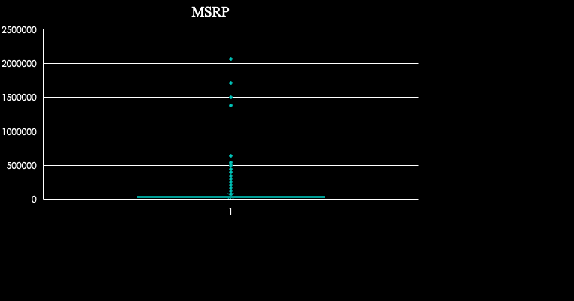
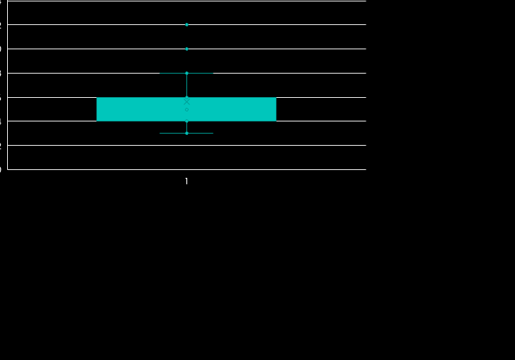



Slide 12




Slide 13
Insight_1 How does the popularity of a car model vary across different market categories?
Market Category | No of Car Models | Popularity
Factory Tuner | 609 | 36863.29
Luxury | 6598 | 15599.24
Exotic | 491 | 1227.13
Hatchback | 1075 | 3669.9
Hybrid | 337 | 21940.86
Performance | 1953 | 28090.64
Flex Fuel | 1179 | 9450.47
Diesel | 202 | 9688.2
High-Performance | 1373 | 104342.31
Crossover | 1994 | 1493.82

Slide 14
It is evident from the table that luxury and crossover market categories have highest car models and diesel category has the least models.
Also, performance and high- performance market categories are the most popular among customers and crossover and factory tuner are not so popular. Also, there is a large disparity in the popularity scale of most and least popular categories.

Slide 15
Insight_2 What is the relationship between a car's engine power and its price?
It is evident from the scatter plot that there is a positive linear relationship between the power of engine and the car’s price. Also, the trend line indicates the same positive linear relation.
Engine Horsepower

Slide 16
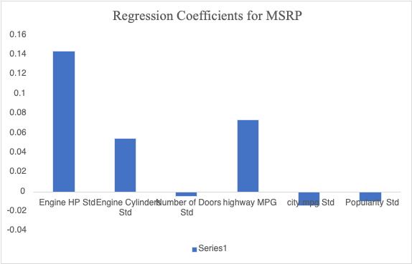
Insight_3 Which car features are most important in determining a car's price?
It can be interpreted through the graph that there is a weak linear correlation between the horsepower of engine and the price of a car. Also, the cars with good highway mileage are offered at a higher price.
As the number of cylinders in a car increases, the price also increases.
Manufacturer’s suggested retail price (MSRP) and variables such as number of doors, city mileage and popularity have a negative correlation which suggests that as the value of one of these variables increase, the value of other variable tends to decrease.

Slide 17
Summary output
Regression Statistics
Multiple R | 0.67564978
R Square | 0.456502625
Adjusted R Square | 0.456211258
Standard Error | 0.02208901
Observations | 11199
 | df | SS | MS | F | Significance F
Regression | 6 | 4.586760361 | 0.76446006 | 1566.759296 | 0
Residual | 11192 | 5.460849676 | 0.000487924
Total | 11198 | 10.04761004

Slide 18
Column | Coefficients | Standard Error | t Stat | P-value | Lower 95% | Upper 95% | Lower 95%2 | Upper 95%3
Intercept | -0.03388608 | 0.001420715 | -23.85142363 | 1.09E-122 | -0.036670931 | -0.031101228 | -0.036670931 | -0.031101228
Engine HP Std | 0.144236157 | 0.002917287 | 49.44187359 | 0 | 0.13851776 | 0.149954553 | 0.13851776 | 0.149954553
Engine Cylinders Std | 0.05466031 | 0.003608305 | 15.1484724 | 2.50E-51 | 0.047587397 | 0.061733223 | 0.047587397 | 0.061733223
Number of Doors Std | -0.004507632 | 0.000484969 | -9.294687637 | 1.75E-20 | -0.005458256 | -0.003557008 | -0.005458256 | -0.003557008
highway MPG | 0.073769191 | 0.008077901 | 9.132222317 | 7.86E-20 | 0.057935084 | 0.089603299 | 0.057935084 | 0.089603299
city mpg Std | -0.013930196 | 0.009004464 | -1.547032137 | 0.121883778 | -0.03158053 | 0.003720138 | -0.03158053 | 0.003720138
Popularity Std | -0.009463982 | 0.000819354 | -11.55054714 | 1.09E-30 | -0.011070059 | -0.007857905 | -0.011070059 | -0.007857905
The coefficient values indicate weak linear relationship between all the independent variables and MSRP. However, there is also weak negative correlation between Number of doors and City Mileage.

Slide 19
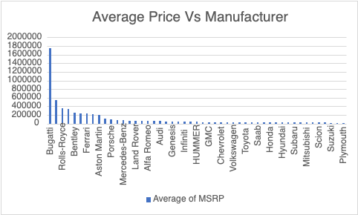
Insight_4 How does the average price of a car vary across different manufacturers?
The manufacturer Bugatti has the highest average price which is also quite high than the other high end manufacturers like Rolls-Royce, Bentley, Ferrari and others.
Manufacturers like Scion, Suzuki and Plymouth have the lowest average price.

Slide 20
Average MSRP per manufacturer
Make | Average of MSRP
Acura | 35087.4878
Alfa Romeo | 61600
Aston Martin | 198123.4615
Audi | 54574.1215
Bentley | 247169.3243
BMW | 62162.55864
Bugatti | 1757223.667
Buick | 29034.18947
Cadillac | 56368.26515
Chevrolet | 29074.72576
Chrysler | 26722.96257
Dodge | 24857.04537
Ferrari | 238218.8406
FIAT | 22670.24194
Ford | 28511.30788
Genesis | 46616.66667
GMC | 32444.08506
Honda | 26655.14781
HUMMER | 36464.41176
Hyundai | 24926.26255
Infiniti | 42640.27134
Kia | 25513.75546
Lamborghini | 331567.3077
Land Rover | 68067.08633
Lexus | 47549.06931
Lincoln | 43860.825
Lotus | 68377.14286
Maserati | 113684.4909
Maybach | 546221.875
Mazda | 20416.62379
McLaren | 239805
Mercedes-Benz | 72069.52786
Mitsubishi | 21340.5625
Nissan | 28921.15245
Oldsmobile | 12843.79545
Plymouth | 3296.873239
Pontiac | 19800.0442
Porsche | 101622.3971
Rolls-Royce | 351130.6452
Saab | 27879.80734
Scion | 19932.5
Spyker | 214990
Subaru | 24240.67364
Suzuki | 18026.4152
Tesla | 85255.55556
Toyota | 28846.5605
Volkswagen | 28978.52289
Volvo | 29724.68421
Grand Total | 41925.92714

Slide 21
Insight_5 What is the relationship between fuel efficiency and the number of cylinders in a car's engine?
Correlation: -0.63193
There is a negative correlation between highway mileage and the number of cylinders, which is also corroborated by the scatter graph.

Slide 22
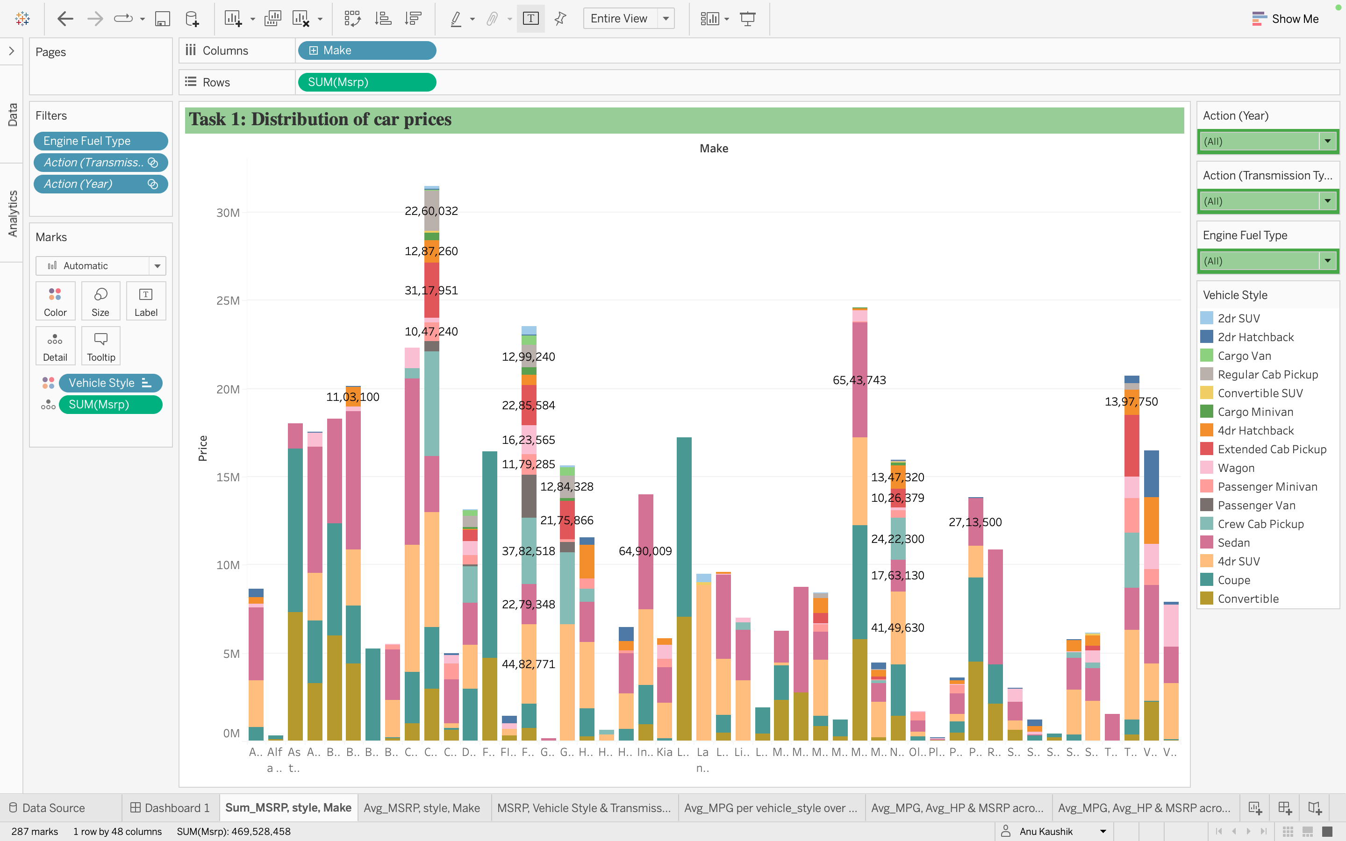
Task_1 How does the distribution of car prices vary by brand and body style?
The car brand Chevrolet holds the highest sum of MSRP, which is followed by Mercedes-Benz.
Among the vehicle style category, Coupe holds the highest sum of MSRPs.

Slide 23
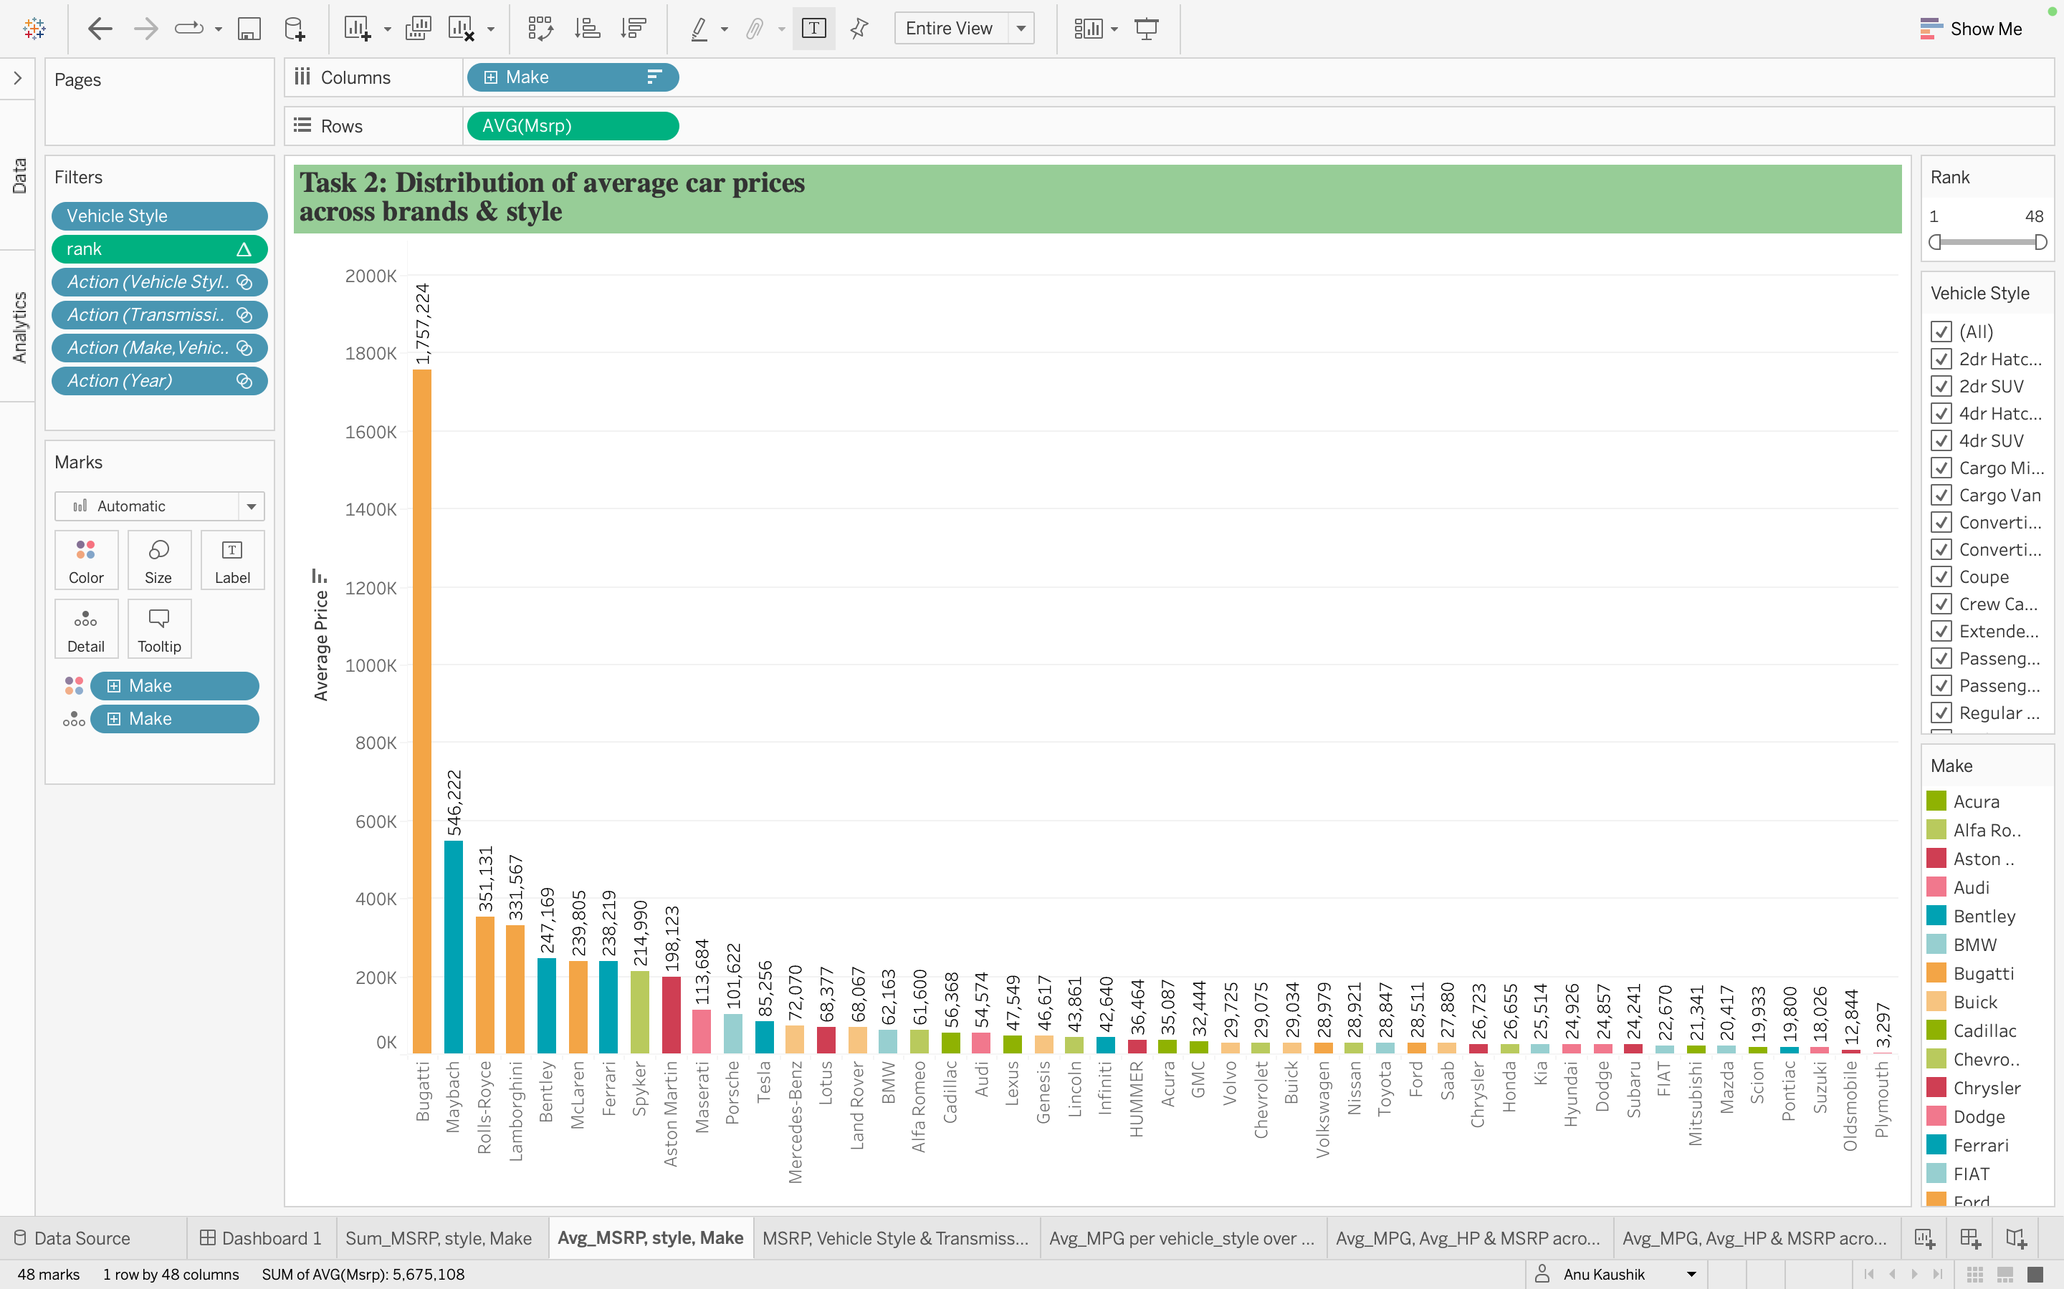
Task_2 Which car brands have the highest and lowest average MSRPs, and how does this vary by body style?
Among all the manufacturers, Bugatti has the highest average MSRP, followed by Maybach, Roll Royce, while Plymouth has the lowest average price for its 2dr Hatchback.
Coupe style of Bugatti has the highest average MSRP, followed by Maybach’s convertible.

Slide 24
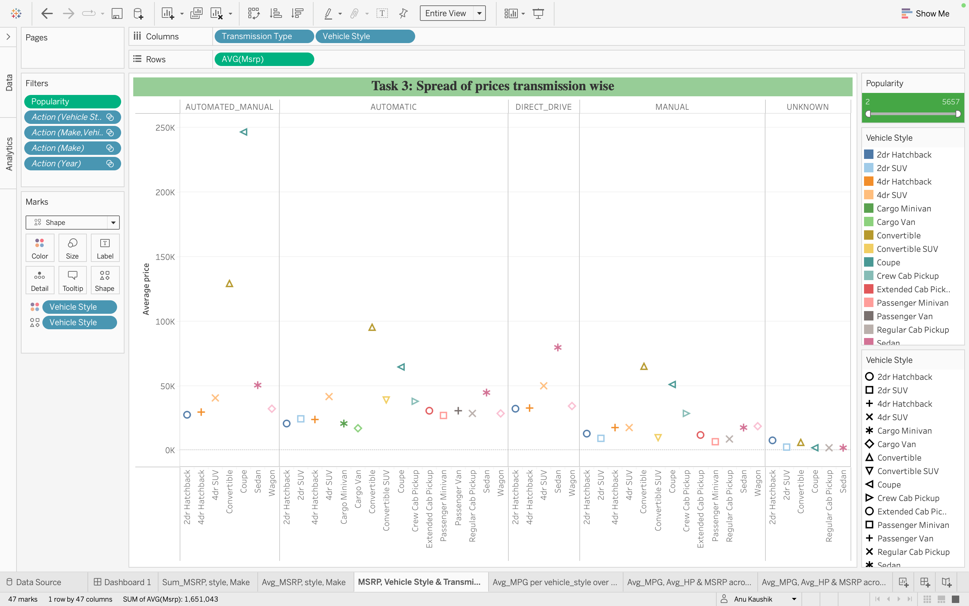
Task_3 How do the different feature such as transmission type affect the MSRP, and how does this vary by body style?
Among all the transmission types, automatic manual Coupe had the highest average MSRP, followed by automatic manual convertible.
Manual transmission type cars have the lowest average MSRPs.
Also, Sedans have the lowest MSRPs.

Slide 25
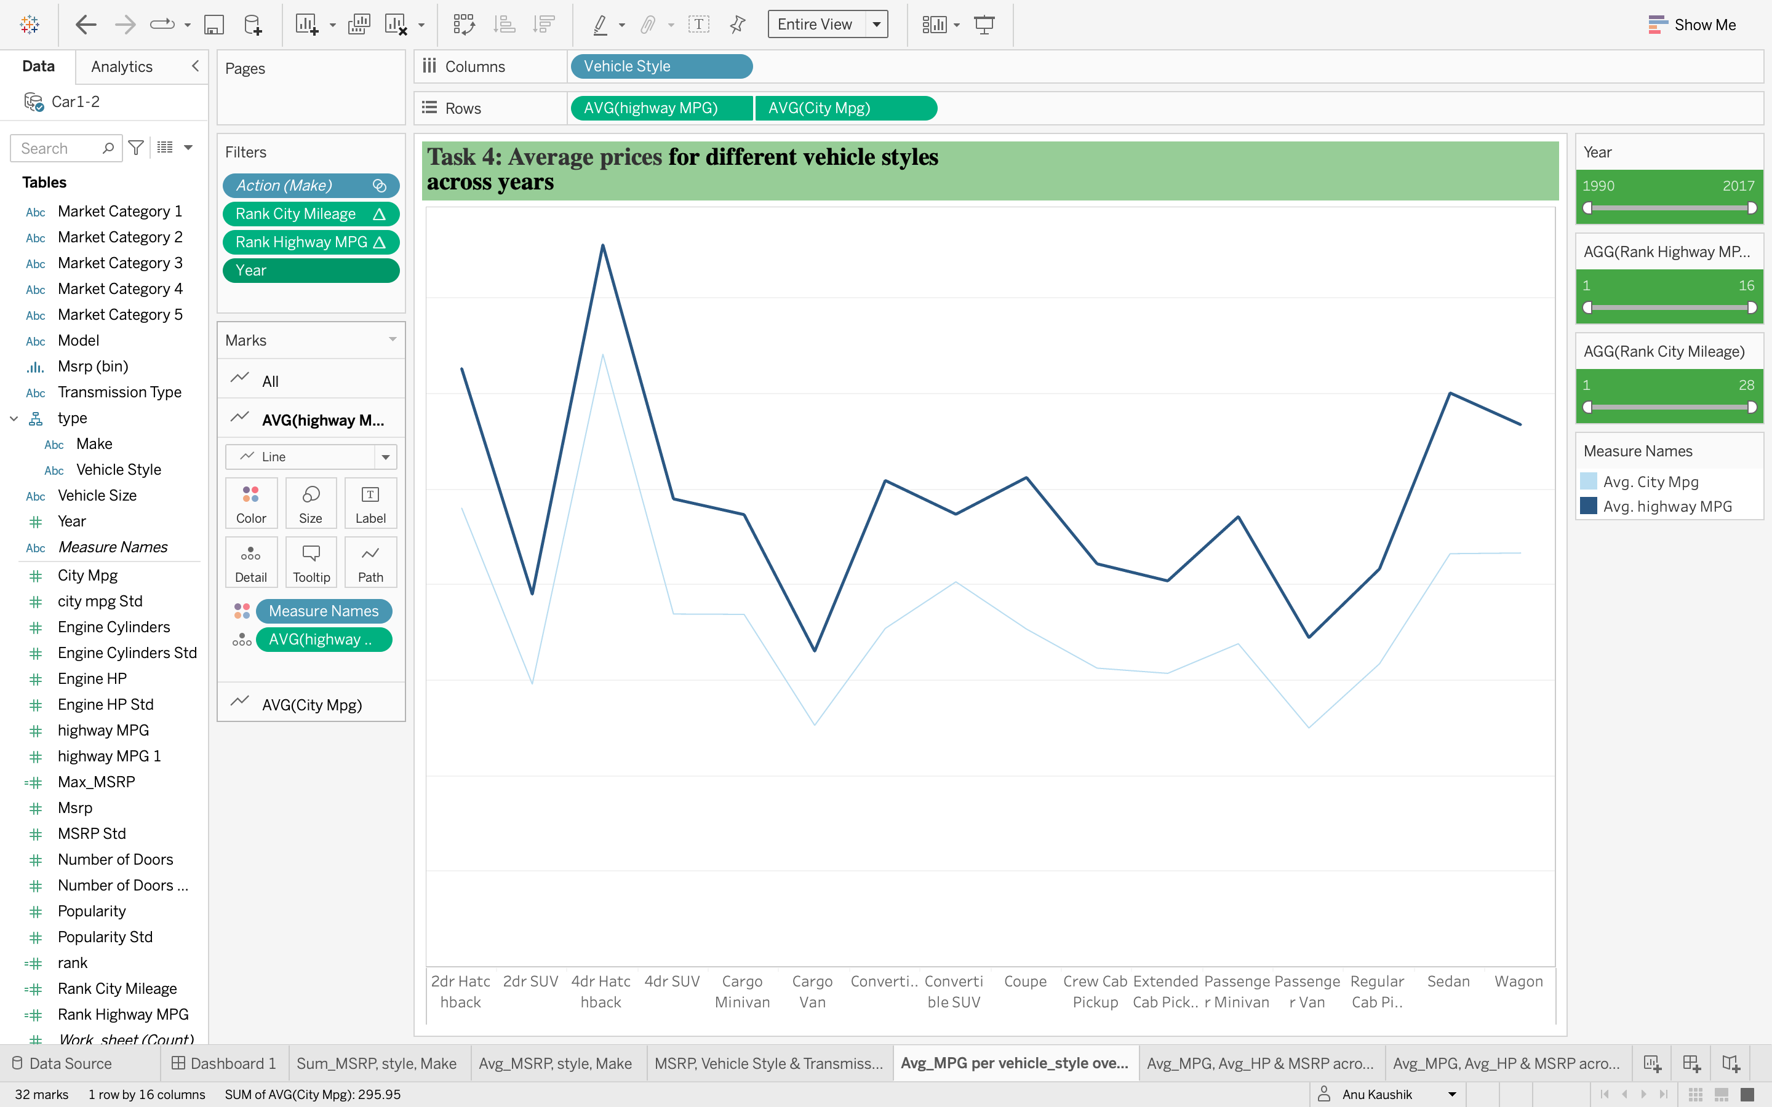
Task_4 How does the fuel efficiency of cars vary across different body styles and model years?
The average mileage for city as well as highways have been increasing over the years, there have been some phases of dip in mileage but the overall trend is increasing.
Also, 4dr Hatchback vehicle style has the highest mileage i.e. most fuel efficient.
Whereas, Cargo Van has the lowest mileage.

Slide 26
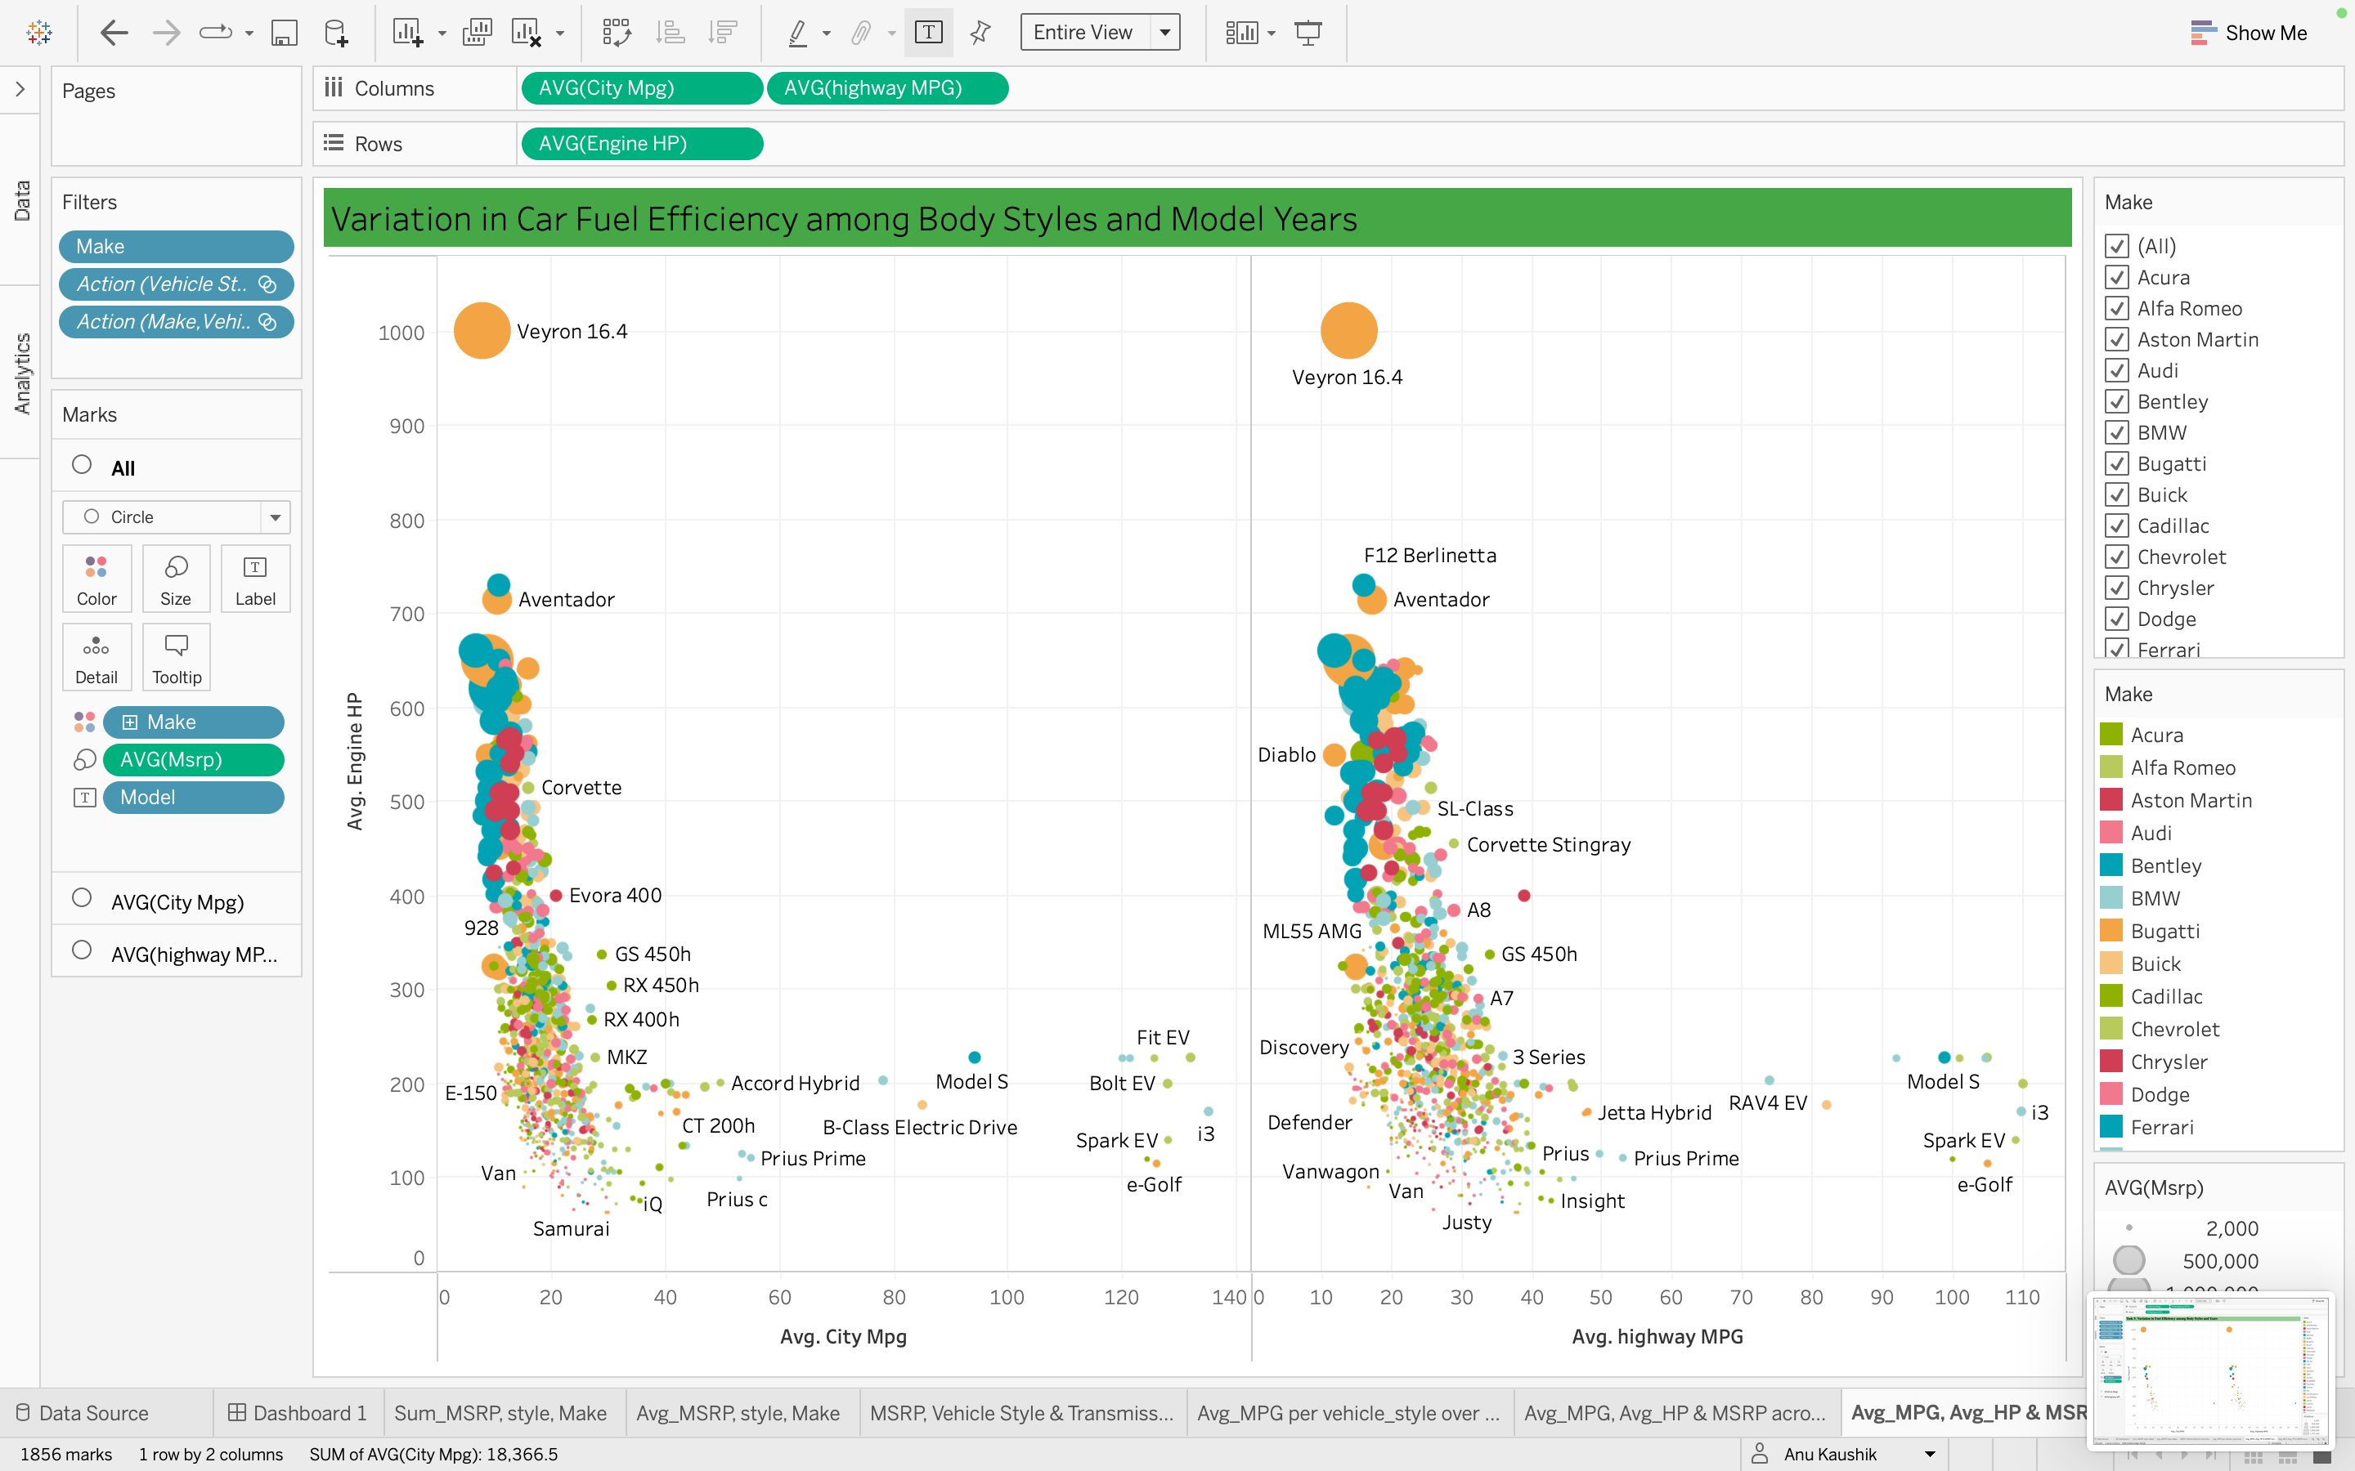
Task_5 How does the car's horsepower, MPG, and price vary across different Brands?
Car model Veyron 16.4 of Bugatti has exhibited the highest horsepower as well as the highest average MSRPs but showcased the lowest mileage for city and highways, followed by Ferrari’s F12 Berlinetta and Lamborghini’s Aventador.
i3 BMW is the most fuel efficient car model in the city mileage segment, while Chevrolet’s Bolt EV had the best highway mileage.

Slide 27
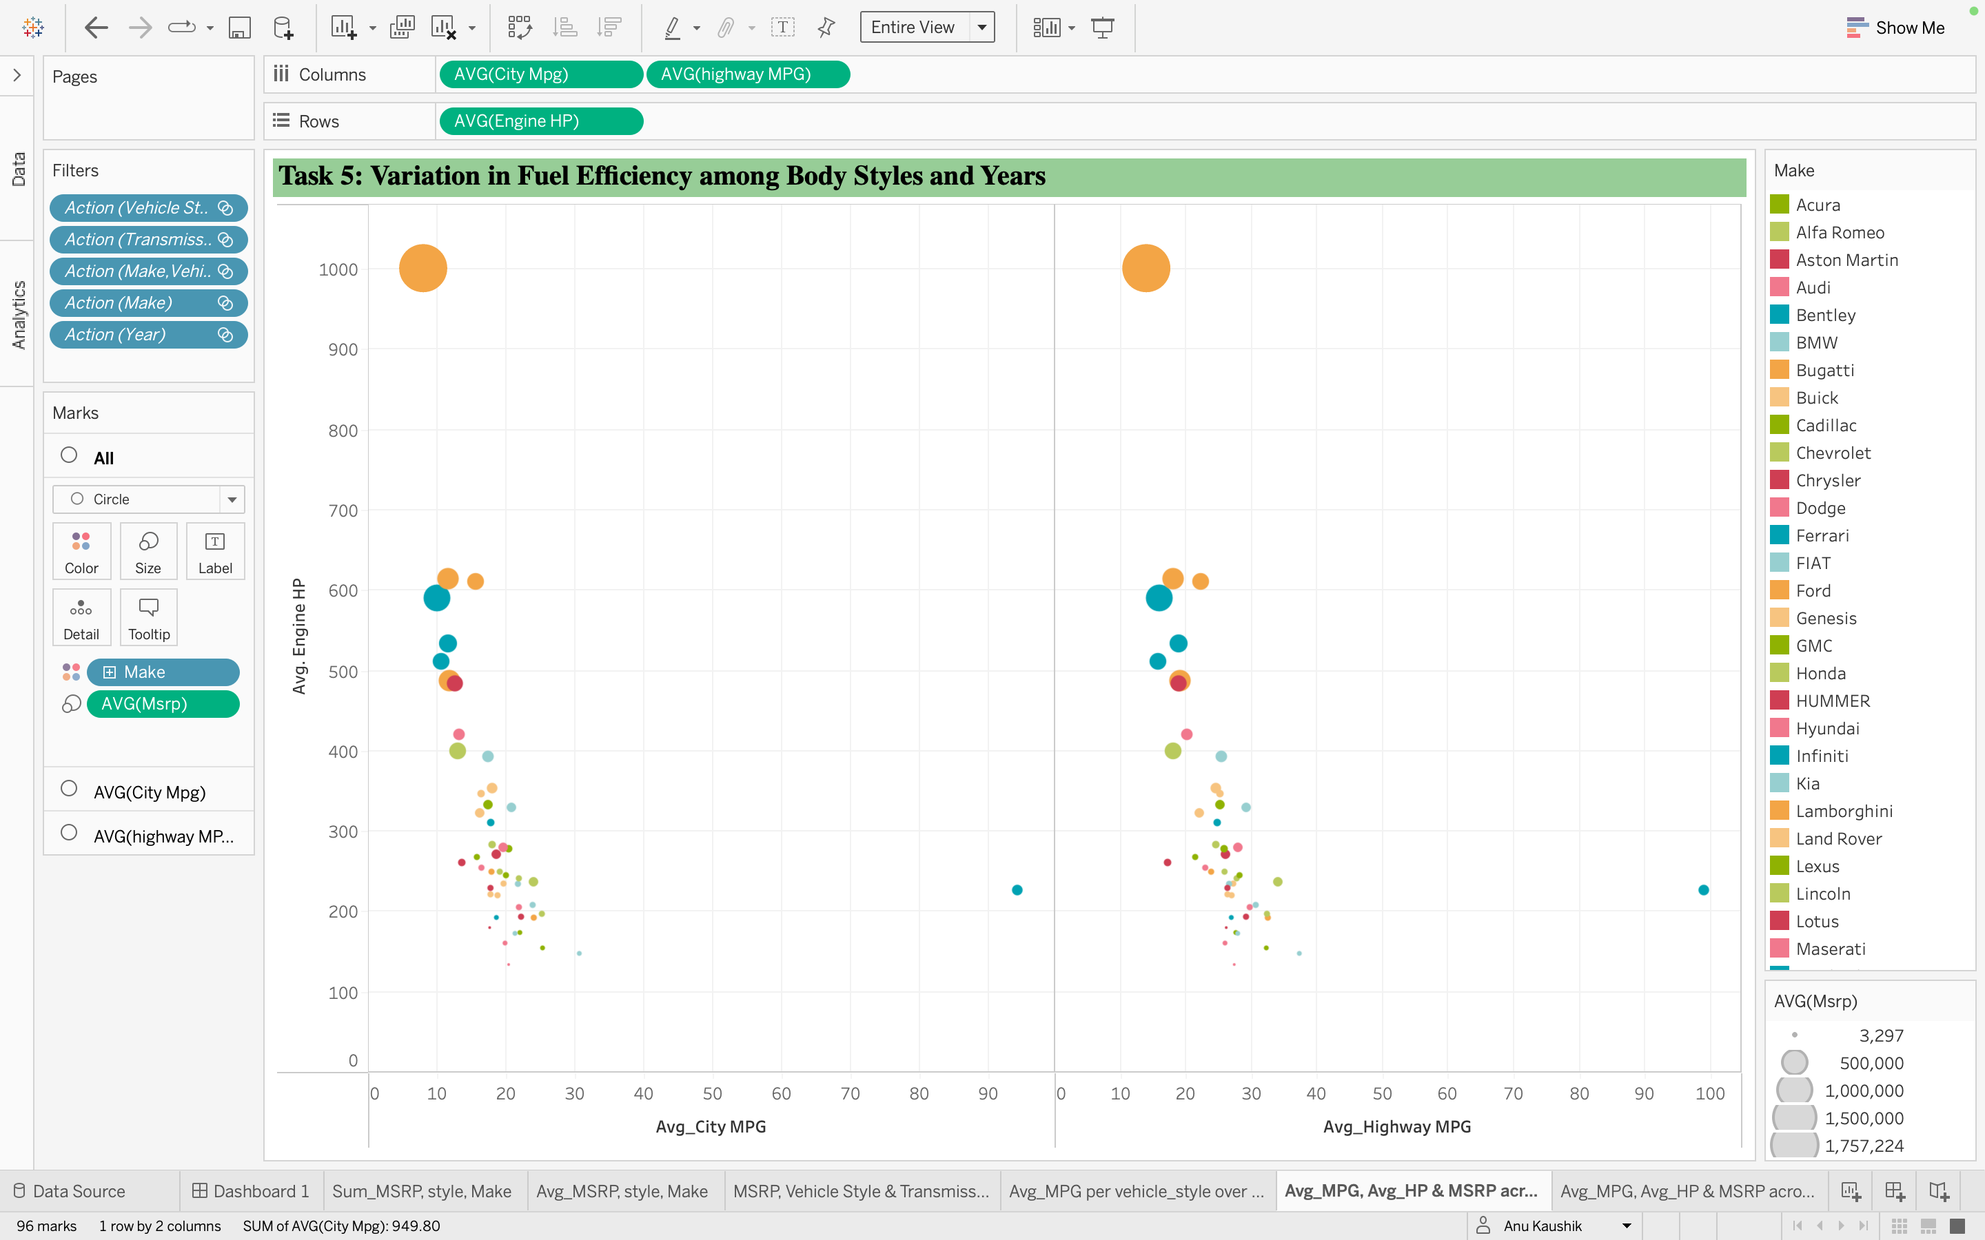
Task_5 How does the car's horsepower, MPG, and price vary across different Brands?
The manufacturer Bugatti has the highest horsepower as well as the highest average MSRP but has a low city and highway mileage.
On the other hand, the manufacturer Tesla has low horsepower cars but these cars have high highway as well as city mileage.

Slide 28
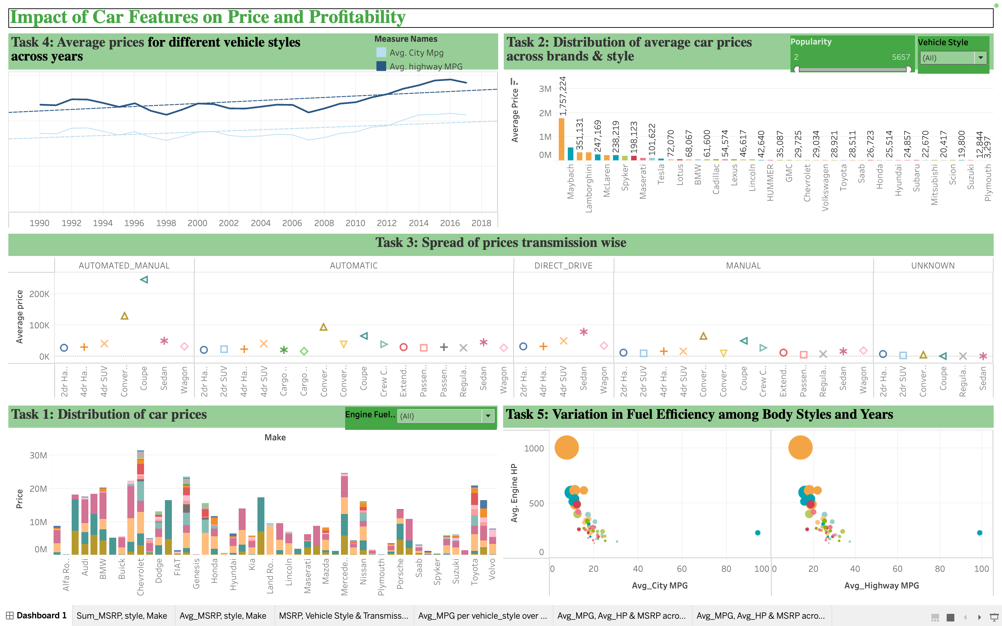
Dashboard

Slide 29
Dashboard Insights
Chevrolet secures the leading position in total MSRP (Manufacturer's Suggested Retail Price) sum, signifying a substantial overall value across its vehicles. Conversely, Bugatti boasts the highest average MSRP, implying premium pricing per vehicle. This discrepancy suggests Chevrolet's wider market presence, as the brand's collective MSRP outpaces Bugatti's despite the latter's higher average pricing.
The vehicle styles of coupes and convertibles exhibit the highest average MSRP (Manufacturer's Suggested Retail Price) compared to other categories.
4dr Hatchback vehicle style is the most fuel efficient, whereas, Cargo Van has the lowest efficiency.
Bugatti's Veyron 16.4 model stands out with the highest horsepower and average MSRP among cars. However, it records the lowest city and highway mileage. Following this trend are Ferrari's F12 Berlinetta and Lamborghini's Aventador.
BMW i3 emerges as the most fuel-efficient car model for city mileage, while Chevrolet's Bolt EV leads in highway mileage efficiency.
Tesla, as a manufacturer, produces cars with lower horsepower. However, these vehicles showcase commendable efficiency with high mileage ratings both on highways and in city driving conditions.

Slide 30
Excel File Link
https://docs.google.com/spreadsheets/d/17Z07ES1pqNTrXFTCPHuFP3jV7A4LCBO3/edit?usp=share_link&ouid=101949921485202693908&rtpof=true&sd=true
https://www.loom.com/share/f4fabec8255f4c16848aa92c008c1392?sid=9a38d9ed-9518-4fdf-a172-72118c414959
https://www.loom.com/share/c021f78c1e6d410888722dc319a8e0cc?sid=f3f2d334-a652-40a8-879a-261ae146d9ff
https://www.loom.com/share/0d4fa05b16f647c4a23b2faeb4480071?sid=440a485e-d2d5-4102-a42b-acf1d7173dbc
https://www.loom.com/share/6b57a57c3c6b4861ab44f060c04ce1fb?sid=c2ef3ea8-f982-4b85-90b9-7c0b21164ec6
https://www.loom.com/share/711e59436e5843b68a6a85b8491f3254?sid=755674d1-1e67-41ec-91a0-e8c91157534a
Loom Video Links

